Slide 1

Data Abstraction & Problem Solving with C++: Walls and Mirrors
Seventh Edition
Chapter 12
Sorted Lists and their Implementations
Copyright © 2017, 2013, 2007 Pearson Education, Inc. All Rights Reserved
Notes:
If this PowerPoint presentation contains mathematical equations, you may need to check that your computer has the following installed:
1) MathType Plugin
2) Math Player (free versions available)
3) NVDA Reader (free versions available)

Slide 2
Specifying the A D T Sorted List (1 of 2)
A D T Sorted list is a container of items
Determines and maintains order of its entries by their values.
For simplicity, we will allow sorted list to contain duplicate items

Slide 3
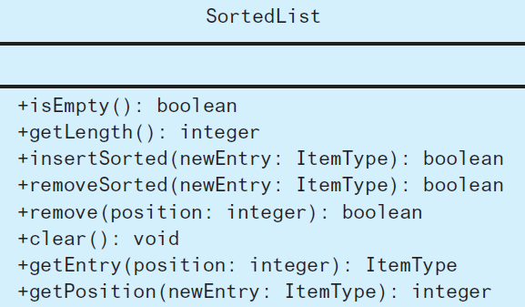
Specifying the A D T Sorted List (2 of 2)
Figure 12-1 U M L diagram for the A D T sorted list

Slide 4
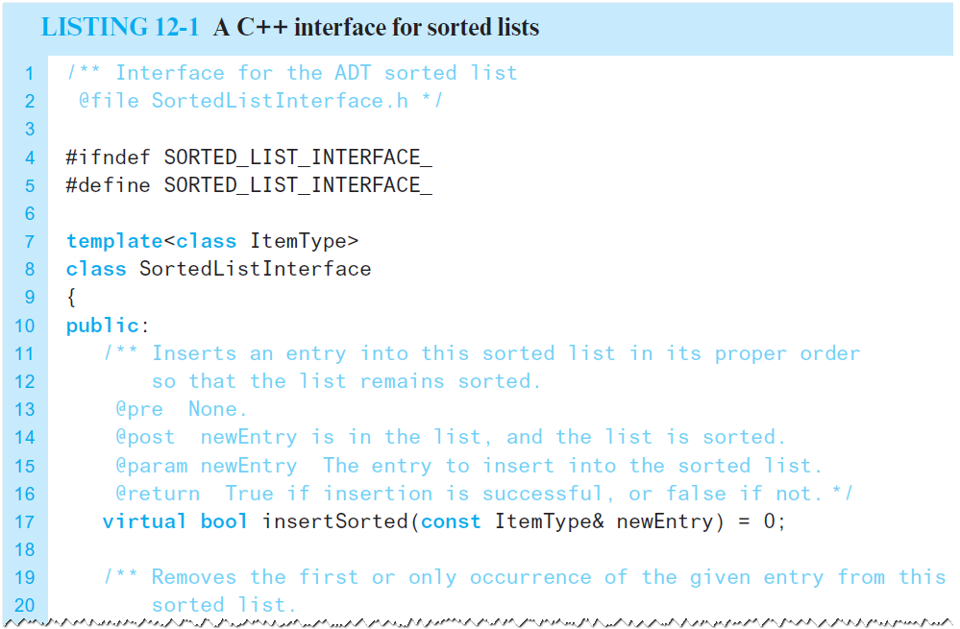
Interface Template for the A D T Sorted List (1 of 4)
Listing 12-1 A C++ interface for sorted lists

Slide 5
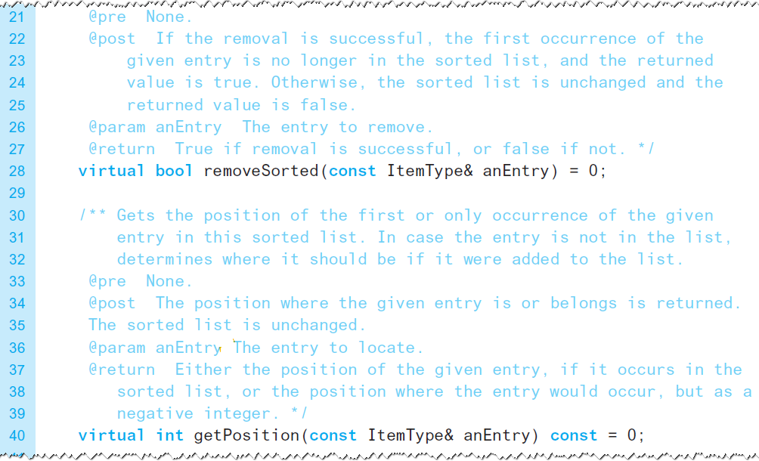
Interface Template for the A D T Sorted List (2 of 4)
Listing 12-1 [Continued]

Slide 6

Interface Template for the A D T Sorted List (3 of 4)
Listing 12-1 [Continued]

Slide 7
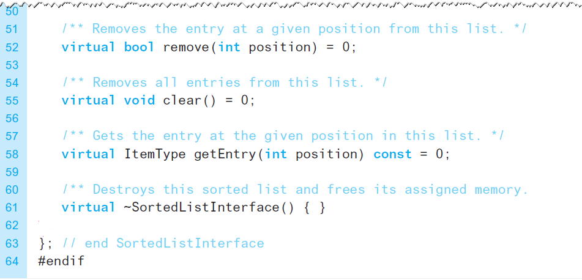
Interface Template for the A D T Sorted List (4 of 4)
Listing 12-1 [Continued]

Slide 8
Using the Sorted List Operations
A D T sorted list can
Add, remove, locate an entry
Given the entry as an argument
Operations same as A D T list operations
getEntry (by position)
remove (by position)
clear
getLength
isEmpty
Note: not possible to add or replace entry by position

Slide 9
Link-Based Implementation
Option for different ways to implement
Array
Chain of linked nodes
Instance of a vector
Instance of A D T list
We first consider a chain of linked nodes

Slide 10
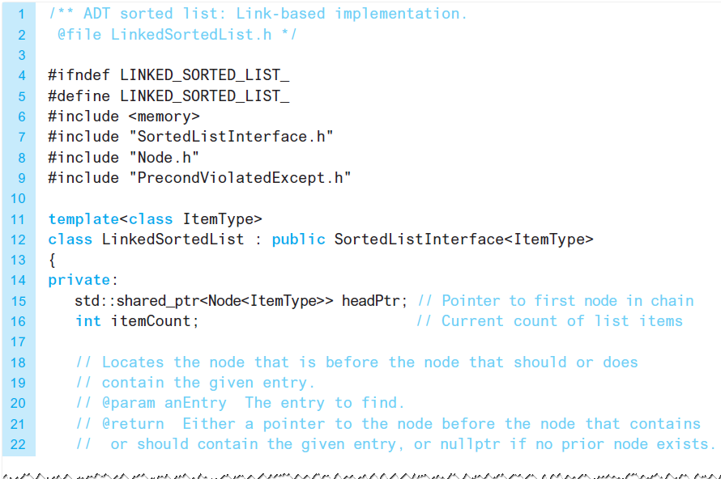
The Header File (1 of 2)
Listing 12-2 The header file for the class LinkedSortedList

Slide 11
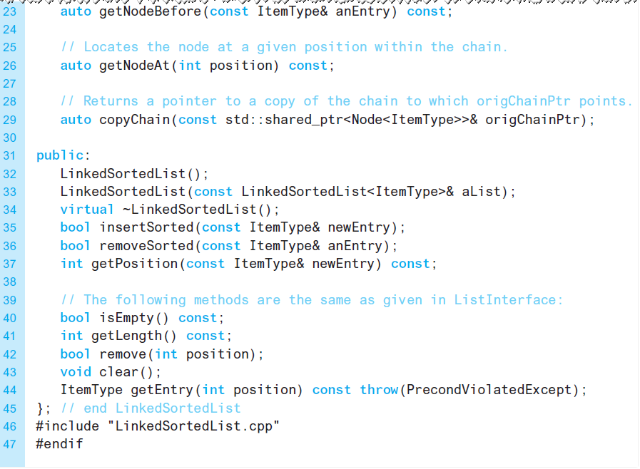
The Header File (2 of 2)
Listing 12-2 [Continued]

Slide 12
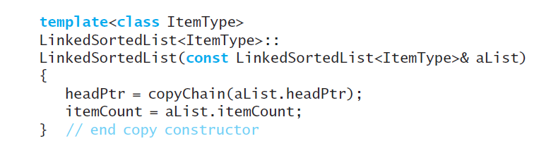
The Implementation File (1 of 4)
Copy constructor calls private method copyChain

Slide 13
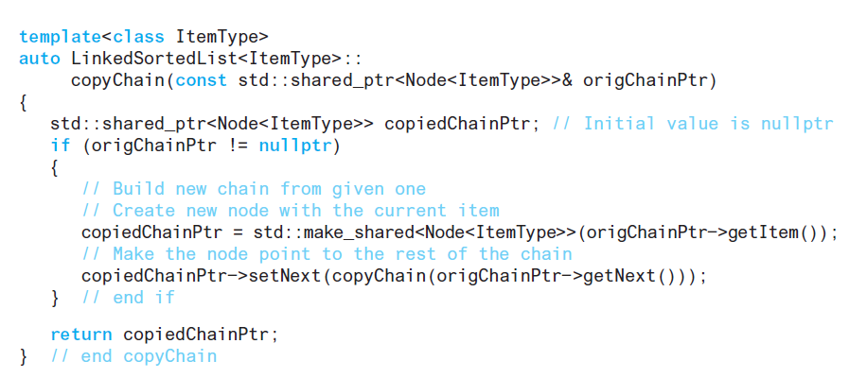
The Implementation File (2 of 4)
Private method copyChain

Slide 14
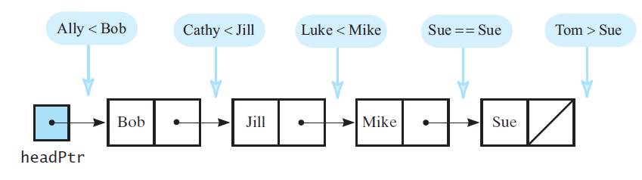
The Implementation File (3 of 4)
Figure 12-2 Places to insert strings into a sorted chain of linked nodes

Slide 15
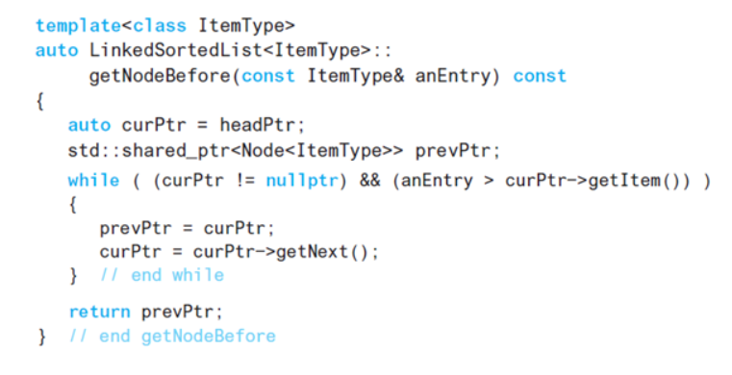
The Implementation File (4 of 4)
Private method getNodeBefore

Slide 16
Efficiency of the Link-Based Implementation
Depends on efficiency of method getNodeBefore
Locates insertion point by traversing chain of nodes
Traversal is

Slide 17
Implementations That Use the A D T List
Avoid duplication of effort
Reuse portions of list’s implementation
Use one of three techniques
Containment
Public inheritance
Private inheritance

Slide 18
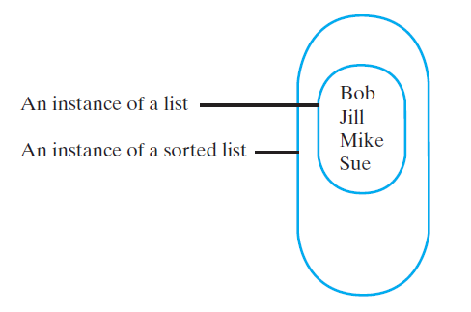
Containment (1 of 9)
Figure 12-3 An instance of a sorted list that contains a list of its entries

Slide 19
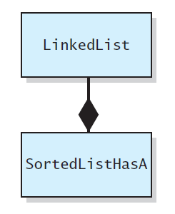
Containment (2 of 9)
Figure 12-4 SortedListHasA is composed of an instance of the class LinkedList

Slide 20
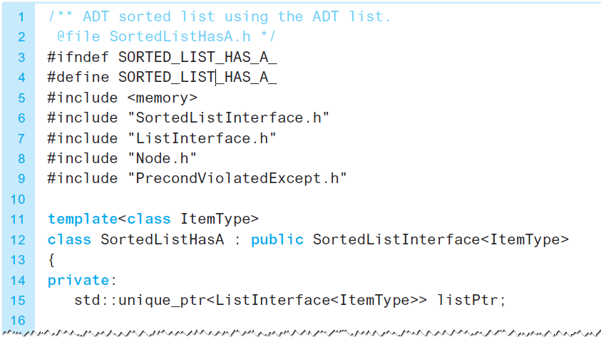
Containment (3 of 9)
Listing 12-3 The header file for the class SortedListHasA

Slide 21
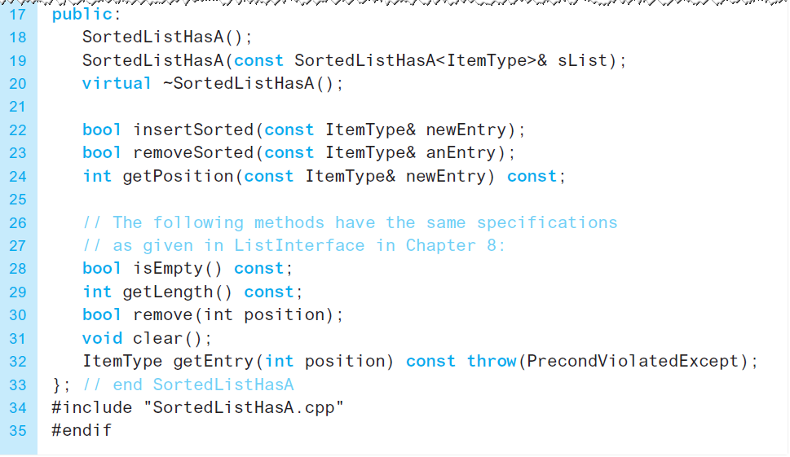
Containment (4 of 9)
Listing 12-3 [Continued]

Slide 22
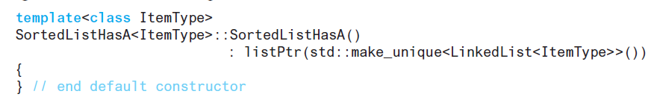
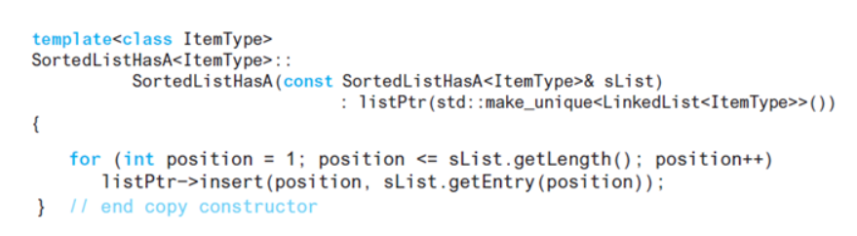
Containment (5 of 9)
Methods

Slide 23
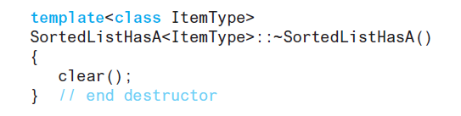
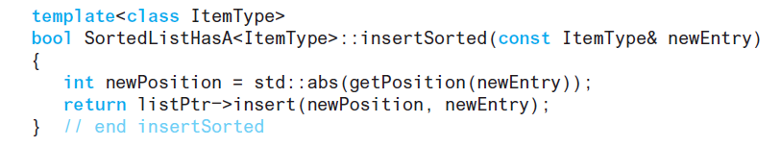
Containment (6 of 9)
Methods

Slide 24
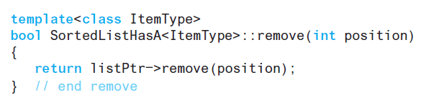
Containment (7 of 9)
Methods

Slide 25

Containment (8 of 9)
Method removeSorted calls getPosition
Method returns false if not found
Other methods
isEmpty
getLength
remove
clear
getEntry
Invoke corresponding list method

Slide 26
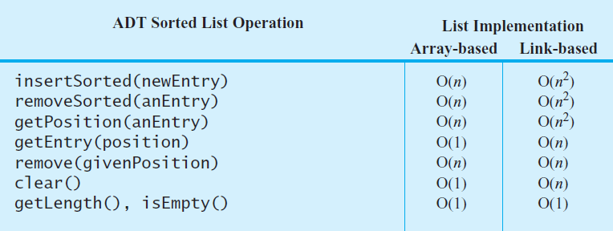
Containment (9 of 9)
Figure 12-6 The worst-case efficiencies of the A D T sorted list operations when implemented using an instance of the A D T list

Slide 27
Public Inheritance (1 of 14)
Most operations for A D T list are almost the same as …
Corresponding operations for A D T sorted list
We use an is-a relationship

Slide 28
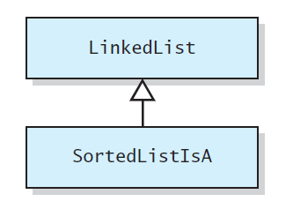
Public Inheritance (2 of 14)
Figure 12-7 SortedListIsA as a descendant of LinkedList

Slide 29
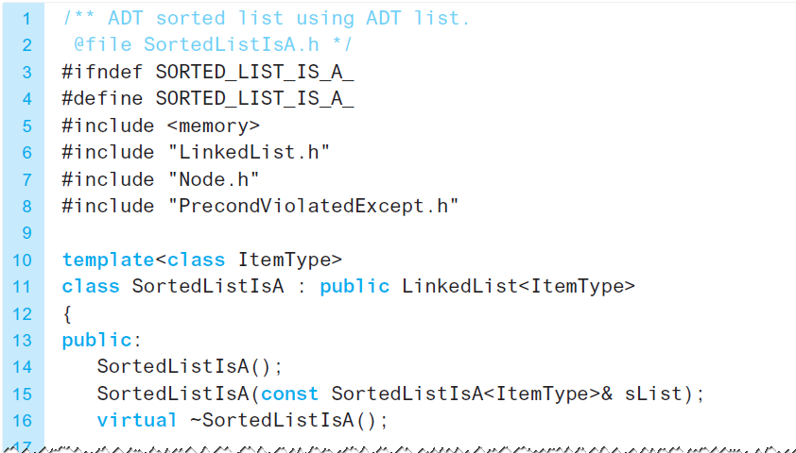
Public Inheritance (3 of 14)
Listing 12-4 A header file for the class SortedListIsA

Slide 30
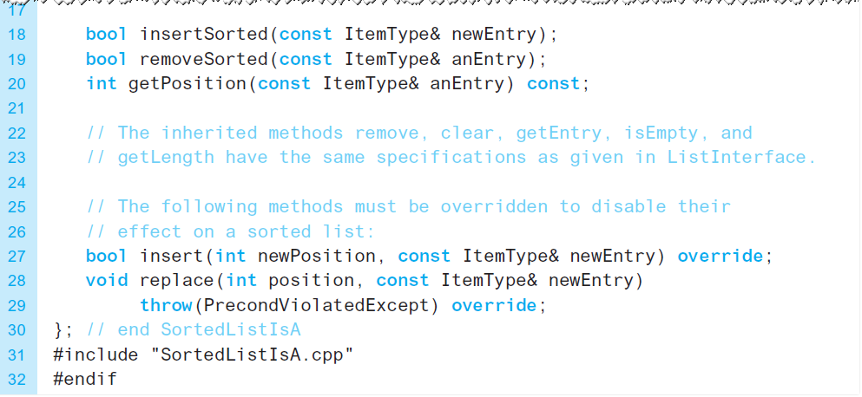
Public Inheritance (4 of 14)
Listing 12-4 [Continued]

Slide 31
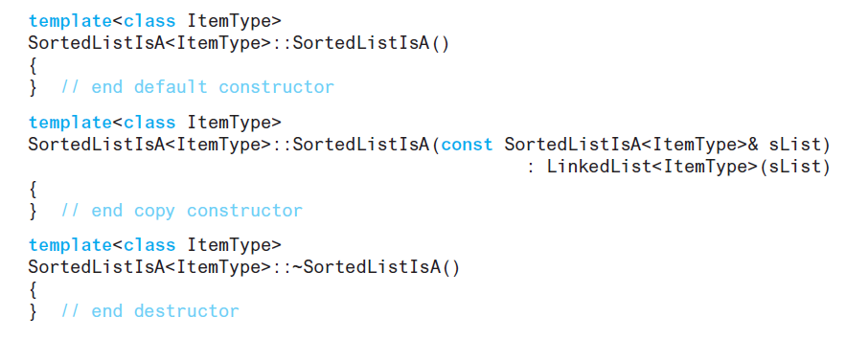
Public Inheritance (5 of 14)
Methods

Slide 32
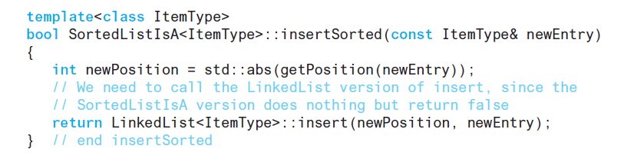
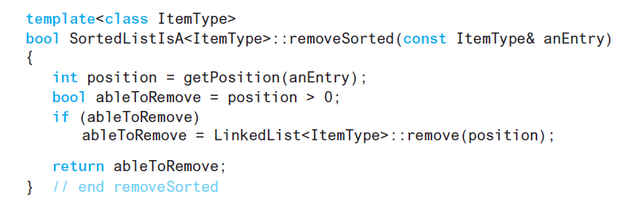
Public Inheritance (6 of 14)
Methods

Slide 33
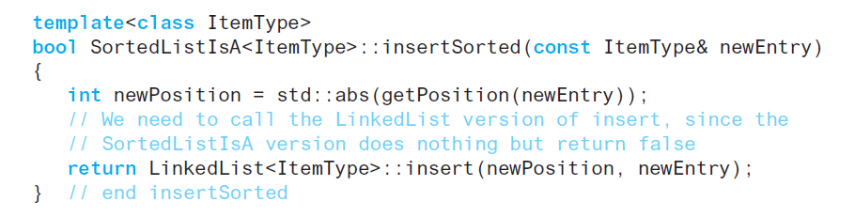
Public Inheritance (7 of 14)
Method insertSorted

Slide 34
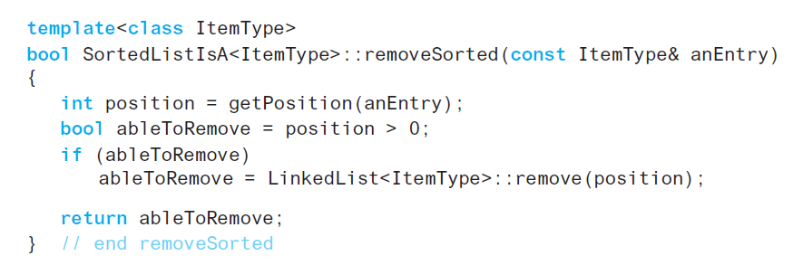
Public Inheritance (8 of 14)
Method removeSorted

Slide 35
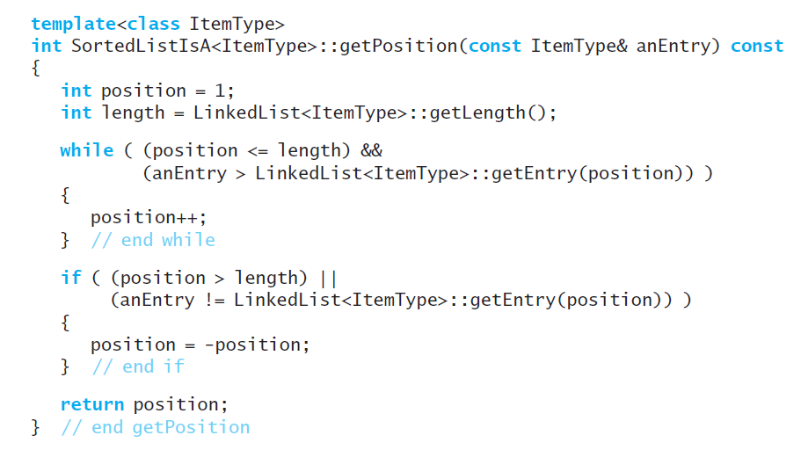
Public Inheritance (9 of 14)
Method getPosition

Slide 36
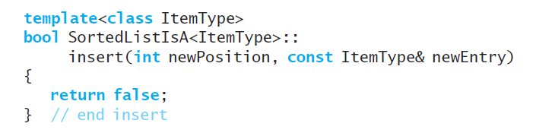
Public Inheritance (10 of 14)
Method insert overridden to always return false. Prevents insertions into a sorted list by position

Slide 37
Public Inheritance (11 of 14)
Possible that an is-a relationship does not exist
In that case do not use public inheritance
Private inheritance enables use of methods of a base class
Without giving client access to them

Slide 38
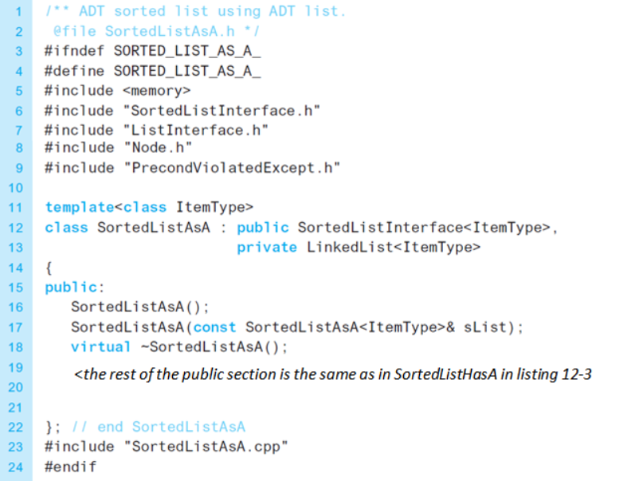
Public Inheritance (12 of 14)
Listing 12-5 The header file for the class SortedListAsA

Slide 39
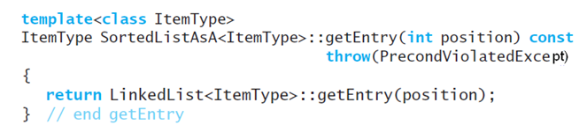
Public Inheritance (13 of 14)
Implementation can use
Public methods
Protected methods
Example

Slide 40
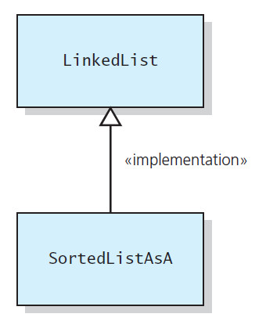
Public Inheritance (14 of 14)
Figure 12-8 The SortedListAsA class implemented in terms of the LinkedList class

Slide 41

Copyright

